Slide 1




Idea to Prevent Acid rain presented by: A .Kavin cse B A .jeffri Manni cse B A .Jameer Hussain cseB E.S. Kavin cse B
SOCIAL GOOD

Slide 2
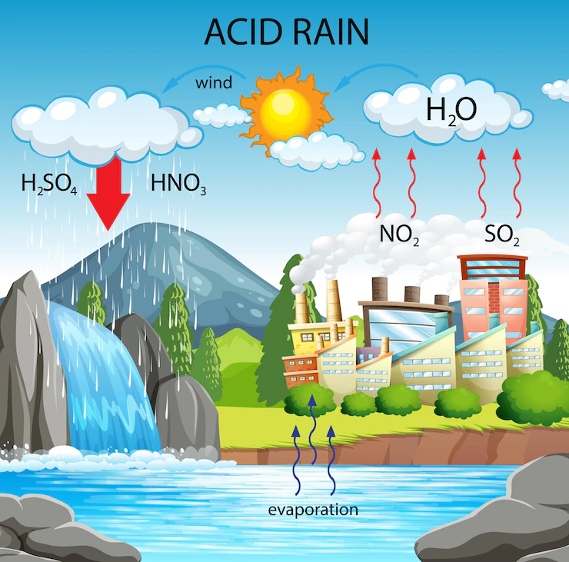
How acid rain occur: Acid rain is caused when Sulphur dioxide and nitrogen oxides are released from carbon particles outlets of (vehicles and industries , etc …) into the air. These substances are attached to the cloud and the same is detached from the cloud during rain and it is called as acid rain. Measuring of acid rain: ⁍ Pure water has a PH value of 7. ⁍ If the PH value varies from 4 to 5, there is a possibility to occur acid rain. ⁍ PH sensors are placed in to the soil for measuring the acid rain

Slide 3
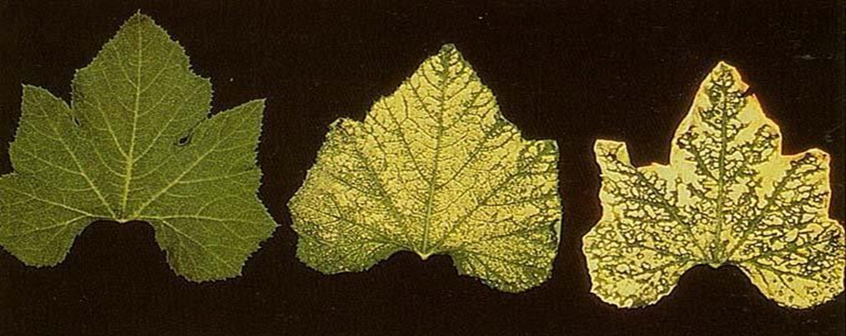
Effects of acid rain :
It irritates eyes and skin of humans.
It affects germination and growth of seedling.
It affects the fertility of soil , destroys plants and aquatic life.
It affects the chlorophyll it plants affecting photosynthesis.
More numbers of dead trees and dying trees are the area where we receive high amount acid rain.

Slide 4
Ways to reduce acid rain:
Few ways to reduce sulfur dioxide and nitrogen oxide from industries is:
Flue gas Desulphuriser (The SNOX process)
Removes sulfur dioxide, nitrogen oxides and particulates from flue gases.
The sulfur is recovered as concentrated sulfuric acid and the nitrogen oxides are reduced to free nitrogen.
The process is based on wet sulfuric acid process (WSA), a process for recovering sulfur from various process gasses in the form of sulfuric acid (H₂SO₄).

Slide 5
Ways to prevent emition from vehicles:
One of the common ways to reduce the Emition of Sulphur dioxide and nitrogen oxide is Catalytic Converter.
We use it because most of our vehicle is powered by fossil fuel energy.
Turning 90% of harmful emissions into less harmful gasses.
It uses expensive metal like platinum or palladium, to speed up the chemical reactions between oxygen and pollutants in the air to convert them into less toxic Byproducts.

Slide 6
Conclusion : In the above slides we saw about acid rain its formation and causes and ways to reduse it . So try to avoid pollution by doing necessary precaution to save our environment.
Reference :
From
https://en.wikipedia.org/wiki/Flue-gas_desulfurization
https://auto.howstuffworks.com/catalytic-converter.htm

Slide 7
Research Presentation End
Thank you
Notes:
You can use this slide as your opening or closing slide. Should you choose to use it as a closing, make sure you review the main points of your presentation. One creative way to do that is by adding animations to the various graphics on a slide. This slide has 4 different graphics, and, when you view the slideshow, you will see that you can click to reveal the next graphic. Similarly, as you review the main topics in your presentation, you may want each point to show up when you are addressing that topic.
Add animation to images and graphics:
Select your image or graphic.
Click on the Animations tab.
Choose from the options. The animation for this slide is “Split”. The drop-down menu in the Animation section gives even more animations you can use.
If you have multiple graphics or images, you will see a number appear next to it that notes the order of the animations.
Note: You will want to choose the animations carefully. You do not want to make your audience dizzy from your presentation.

